Slide 1
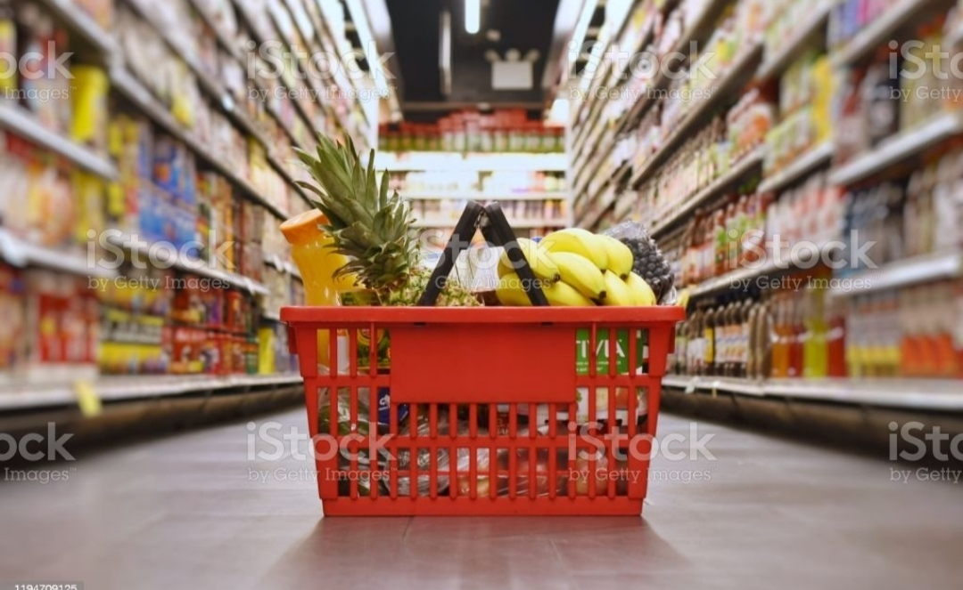
ONLINE GROCERY STORE

Slide 2
INTRODUCTION
Online Grocery Store.
A online grocery store is either a brick-and-mortar super market or grocery store that allows online ordering , or a standalone e-commerce service that includes grocery items.

Slide 3
Scope of online grocery store
A good product quality with affordable price.
Browse on your time.
Avoid the line and shop in the comfort of your home.
Avoid making multiple trips.

Slide 4
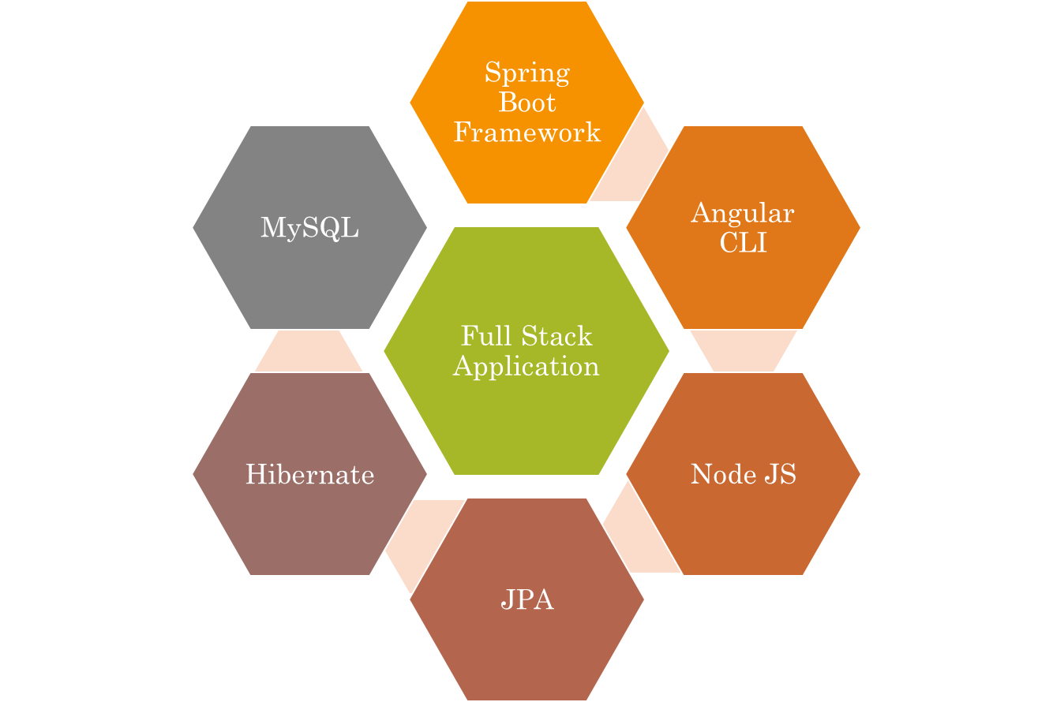
Technologies used.

Slide 5
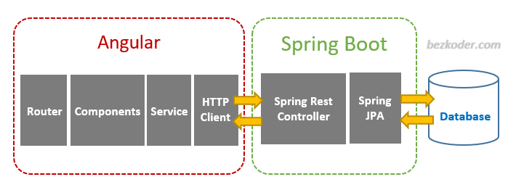
The Architecture of Angular , Spring & database (MYSQL)

Slide 6
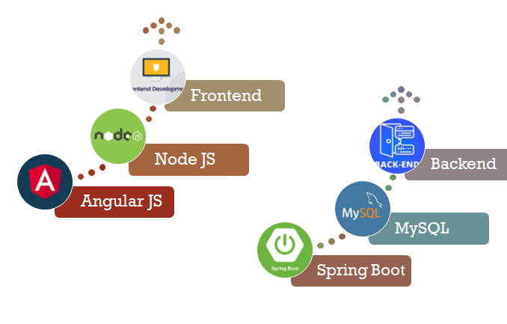
The Architecture of the Project

Slide 7
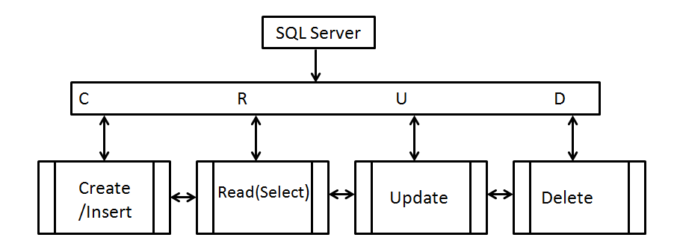
CRUD Operation

Slide 8
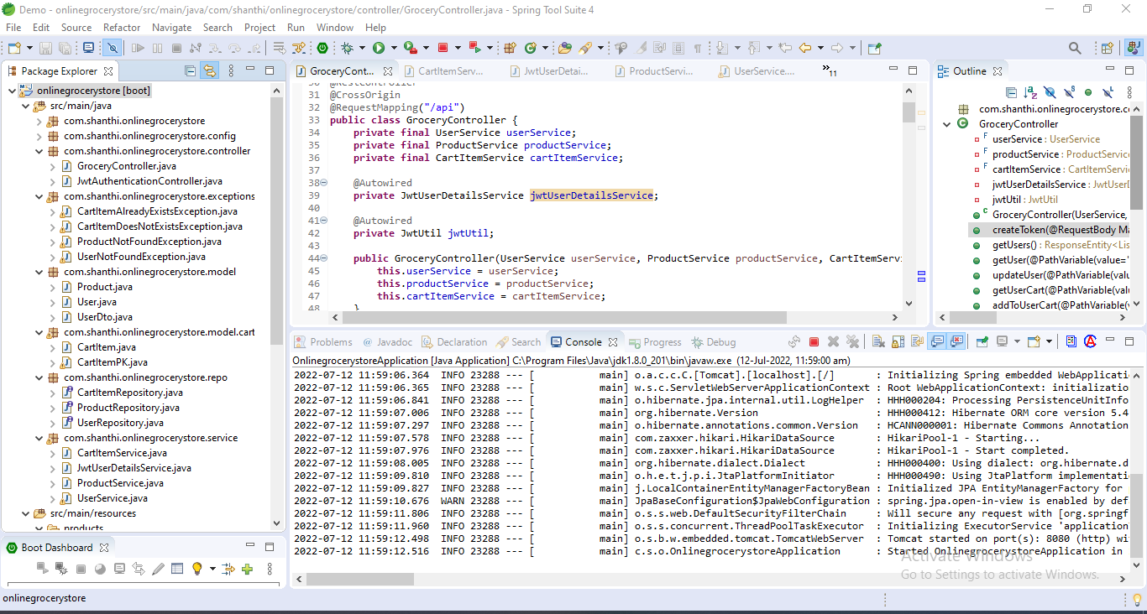
Spring Boot Application

Slide 9
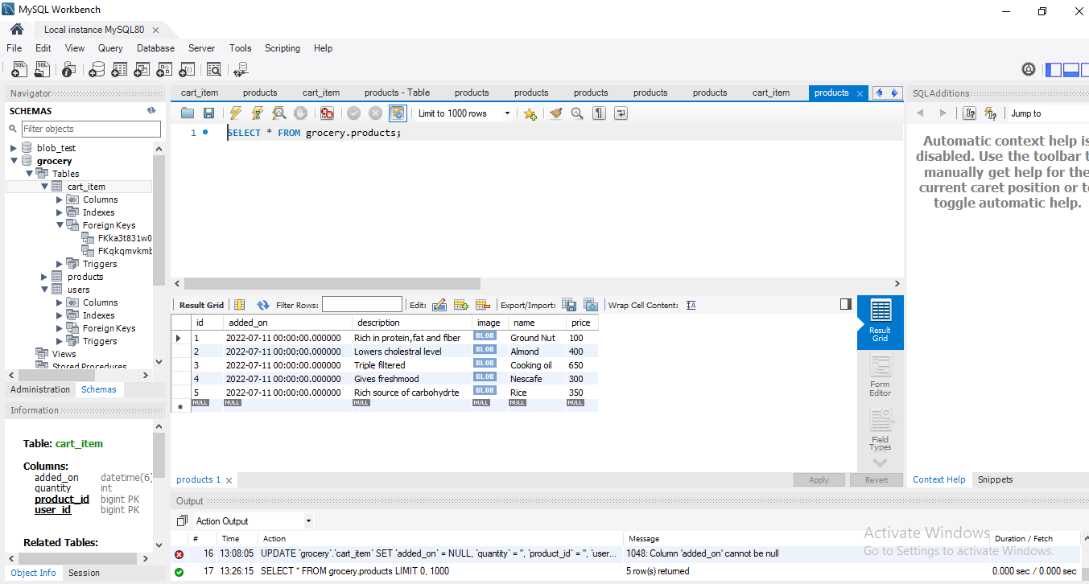
MySQL Code

Slide 10
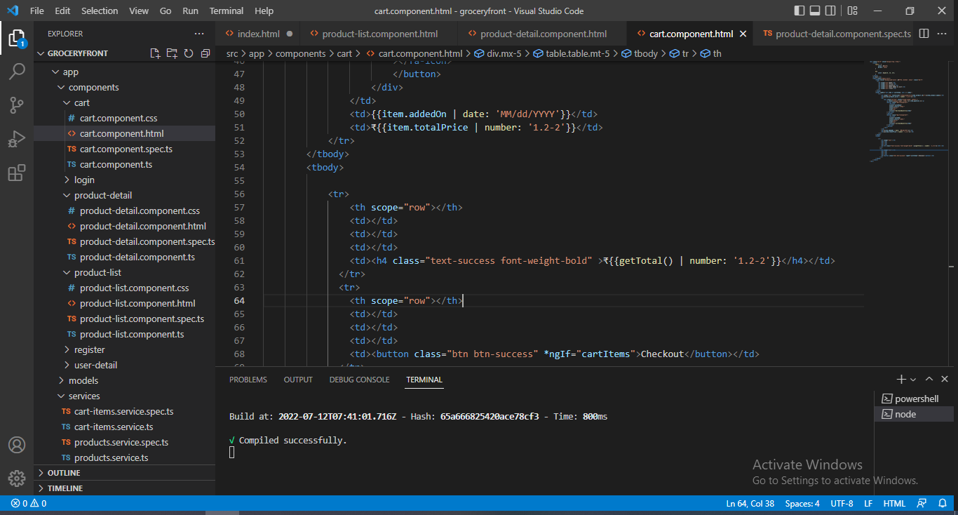
Fronted-Angular JS

Slide 11
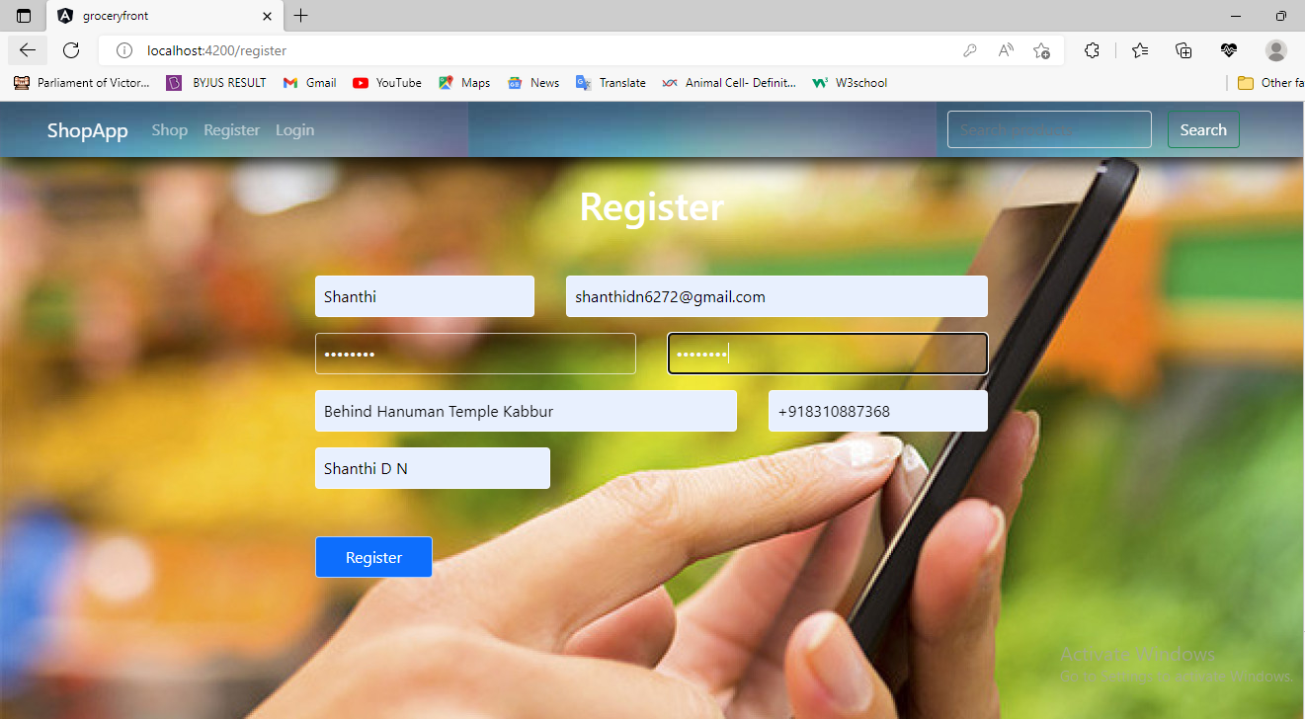
Register page

Slide 12
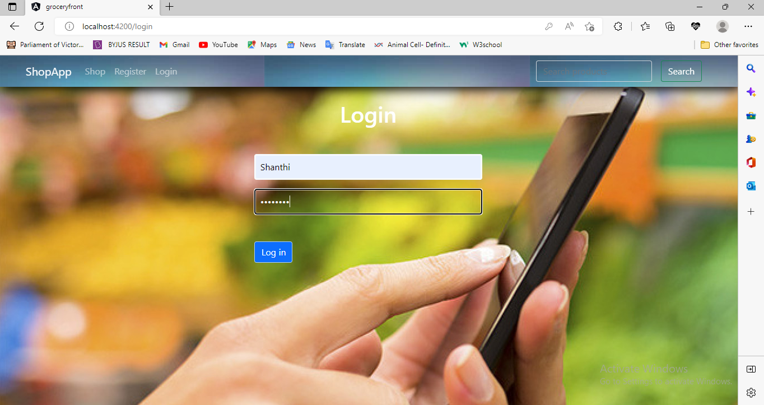
Login page

Slide 13
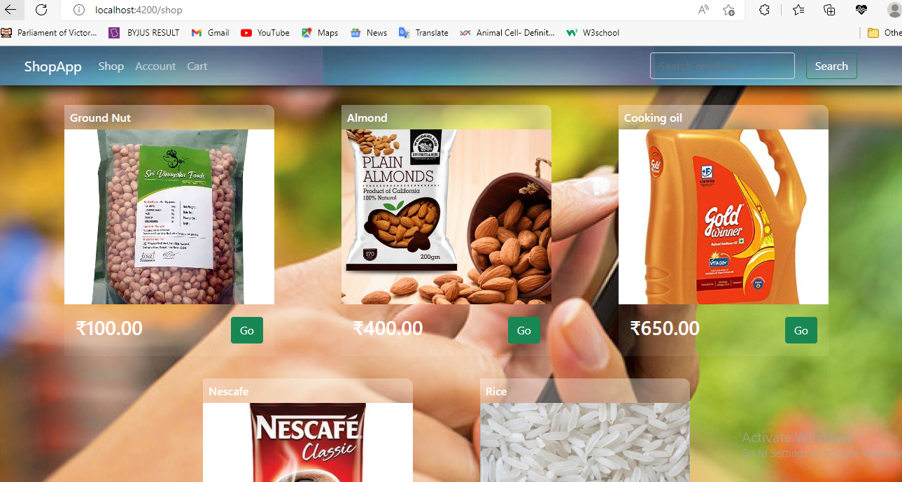
Product page

Slide 14
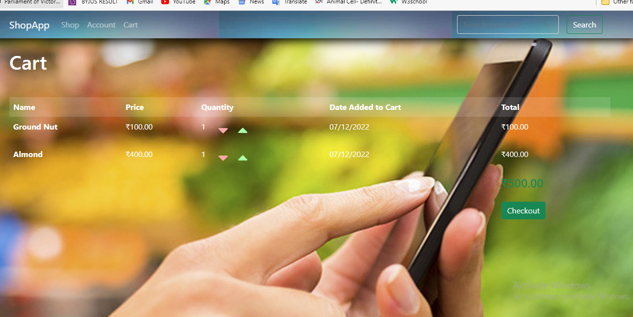
Cart page

Slide 15
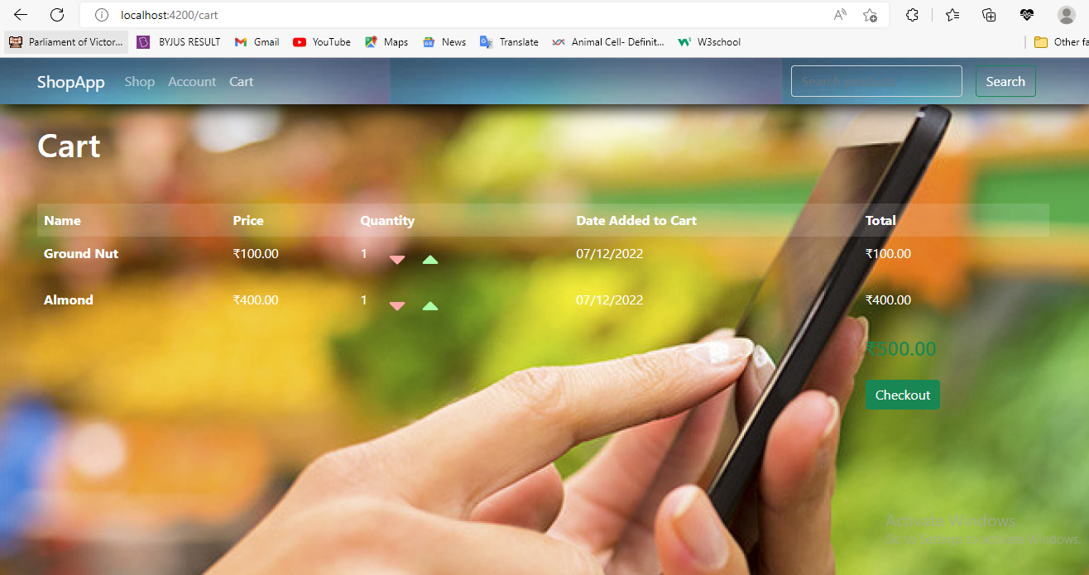
Checkout page

Slide 16

GitHub Link
https://github.com/shanthi777/FullStack-Grocerystore.git

Slide 17
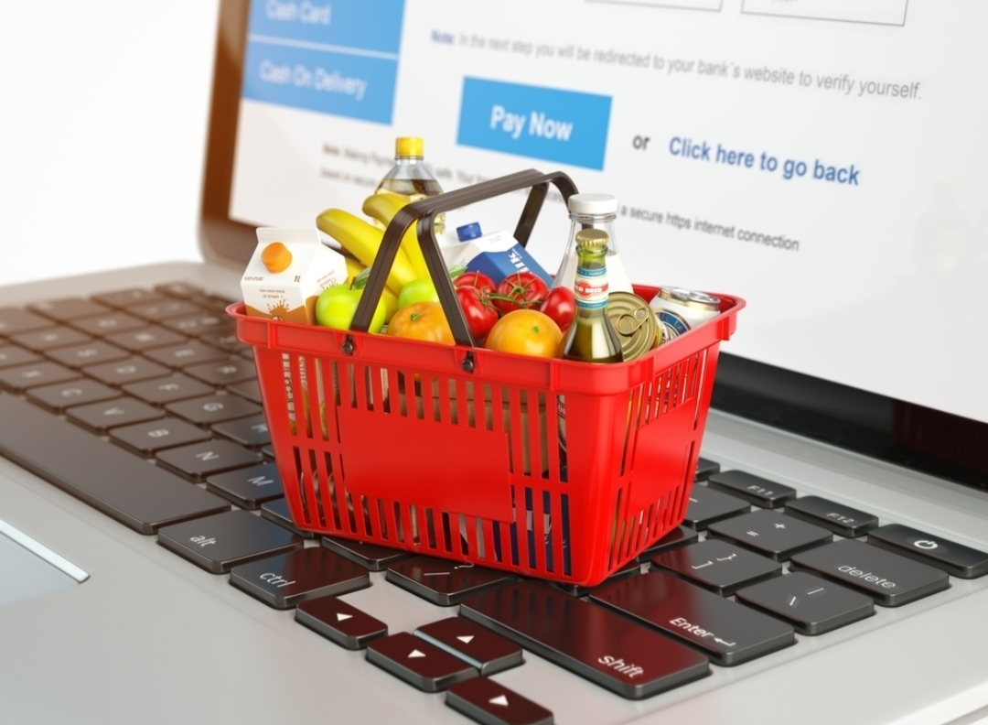
Thank You
- Shanthi D N
- EBE0N0122543384
- 2021-6625.

